Slide 1
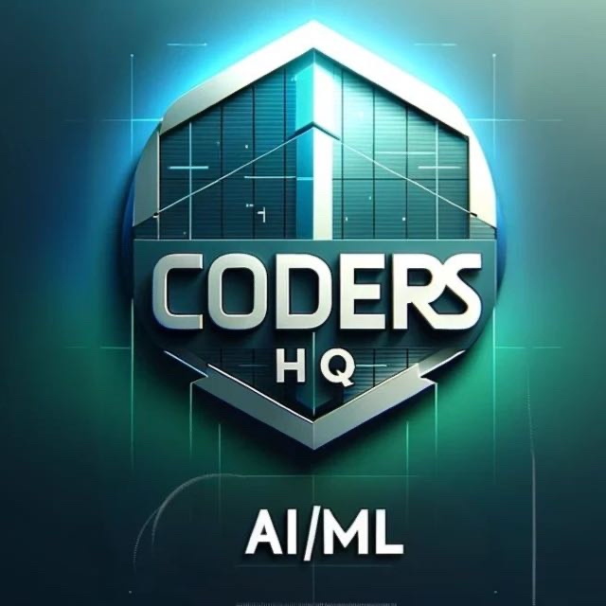
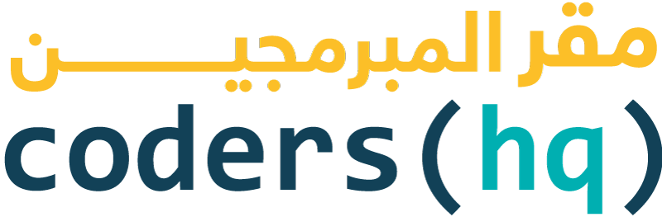

Why one should not directly jump into AI
Speaker: Isham Rashik
AI Community Lead at CodersHQ

Slide 2
Introduction about myself
Brought up in UAE - residing more than 27 years - from primary school till completing Masters.
BEng. Electrical And Electronic Engineer and MBA in Finance and Operations
Worked in multiple sectors - Education, Finance, Telecom, Media, and Research & Development
Currently working as AI Engineer working at KNAI.
Involved in both Classical Machine Learning and Generative AI projects
Overall more than 6 years in the field of State of the Art Technology
Top Voice in Machine Learning, Data Science and Machine Learning on Linkedin from August 2023 till February 2024
Currently also AI Community lead under CodersHQ and one of the Co-Founders of Launchpad.

Slide 3
After this session
You will know what is exactly going on behind the scenes when we use Generative AI
The learning path that will allow us to equip ourselves to become an AI Engineer
Appreciate the technology more as you will know about the mathematics behind AI

Slide 4
Current State of Generative AI
Generative AI has lot of cool applications:
Text to Speech
Speech to Text
Image Generation
Text Generation
And more . . .

Slide 5

Hidden Complexity
These models that we are using are often hidden from us:
Used as API services
Implemented via open-source models
Therefore, forms as blackbox in both scenarios

Slide 6
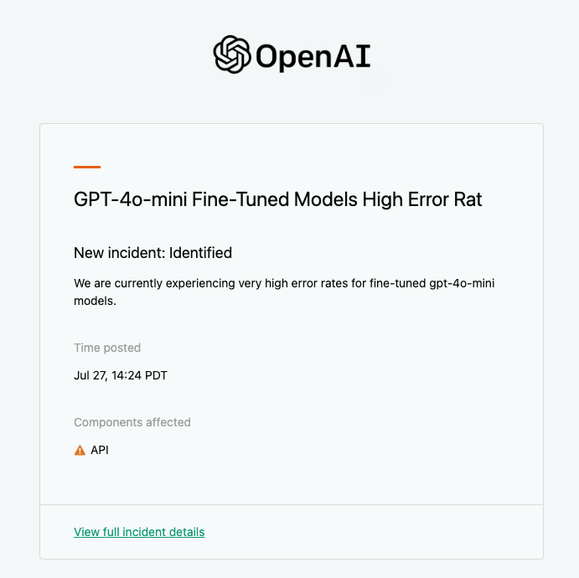
Disadvantages of AI as Services
Sometimes API services can be due to various kind of errors.
One of the common error is that it goes down without any warning
This can be really hefty for the business that relies on the AI services and can cost worth billions of dollars even if the downtime is low

Slide 7
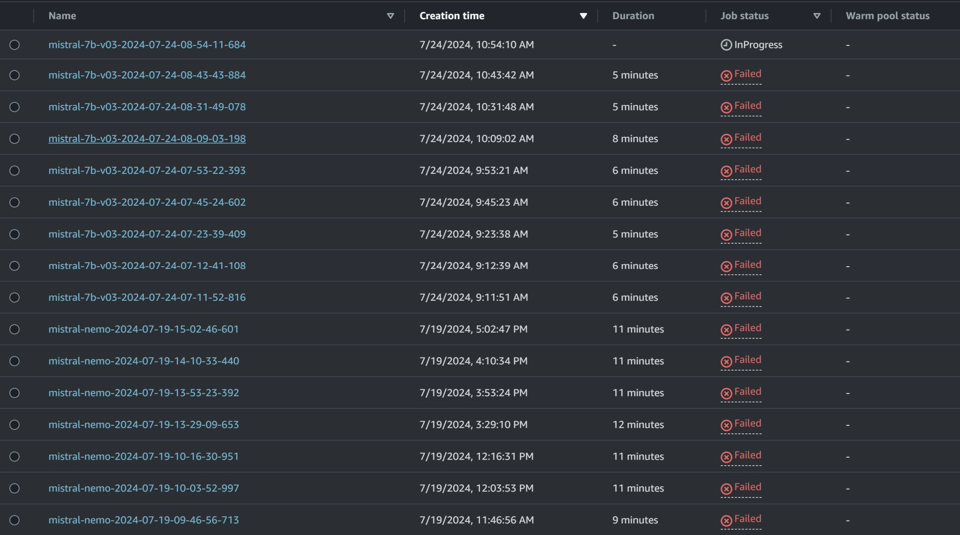
Credits to: Jeremy Arancio

Slide 8

Can we improve Generative AI further as per our requirements?
The answer is YES!

Slide 9
Roadmap for clearing fundamentals
Start from Linear and Logistic Regression (this is more of revision as these are covered in high school)
Have strong base in statistics and calculus – Statquest and 3blue1brown
Have good software engineering foundations and be good at optimizing algorithms and data structures – CS50
Study Deep Learning Algorithms or Deployment Strategies (MLOps)

Slide 10
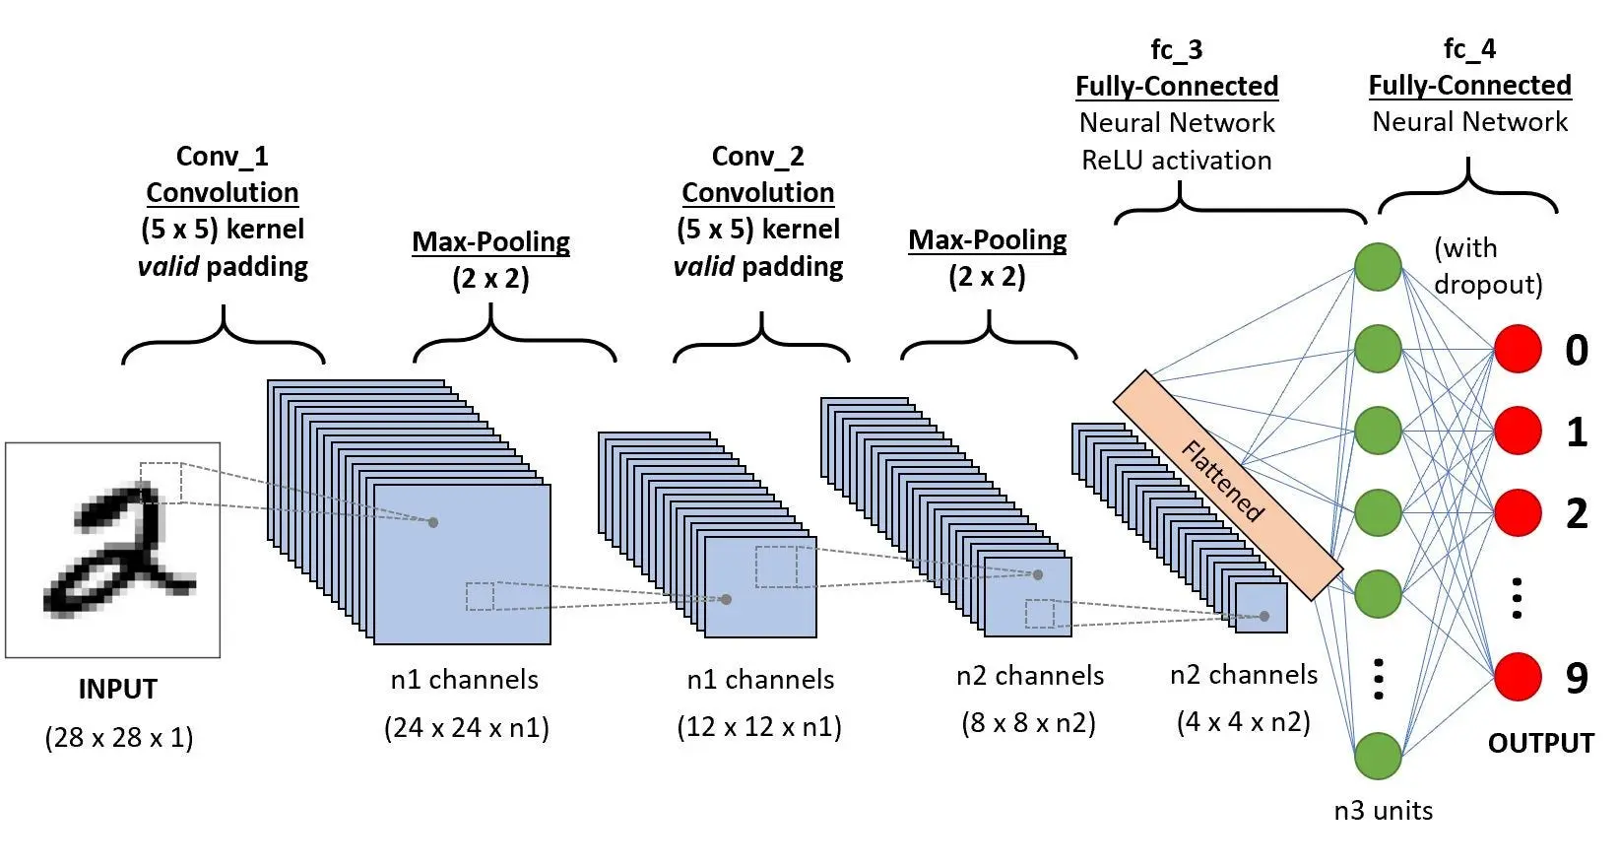
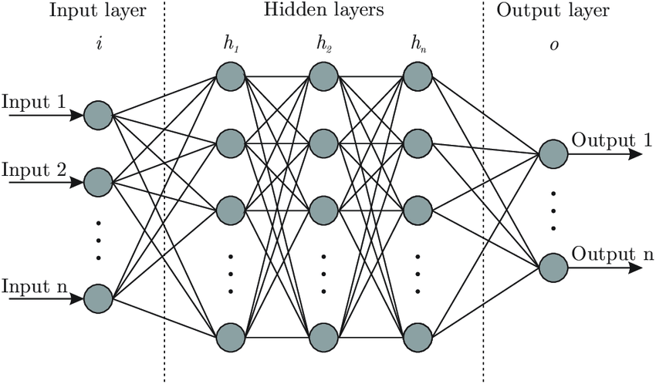
Deep Learning Algorithms
Convolutional Neural Networks (CNN)
Artificial Neural Networks (ANN)

Slide 11
Important Concepts to be studied for each DL Algorithm
Forward Propogation and Backward Propogation
Activation Functions – Sigmoid, ReLu, GeLu etc
Optimizers that allows minimizing of loss – Stochastic Gradient Descent Optimizer and Adam Optimizer
Regularization techniques - Dropout
Normalization – Batch Normalization / Layer Normalization

Slide 12
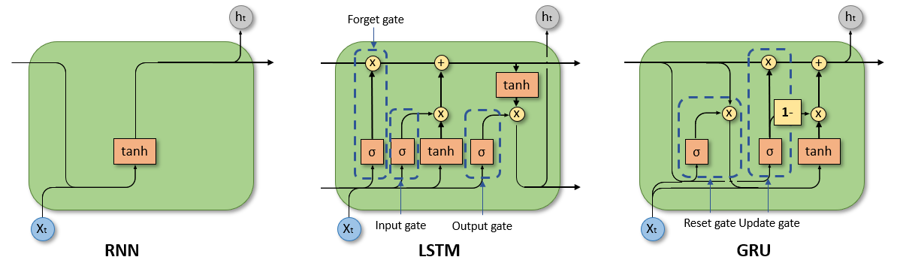
Deep Learning Algorithms - Continuation
Recurrent Neural Network (RNN)
Long Short Term Memory (LSTM)
Gated Recurrent Unit (GRU)

Slide 13
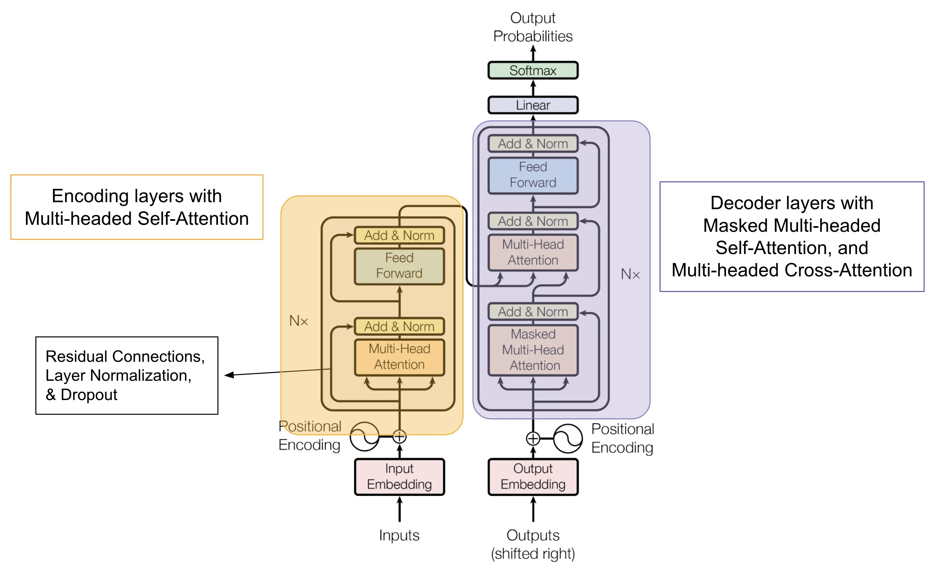
Deep Learning Algorithms - Continuation
Ultimate breakthrough in the world of AI
This architecture is used across all branches:
Computer Vision
Natural Language Processing
Speech
Translation
And more . . .
Transformers

Slide 14
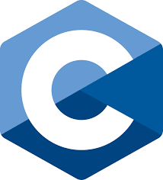
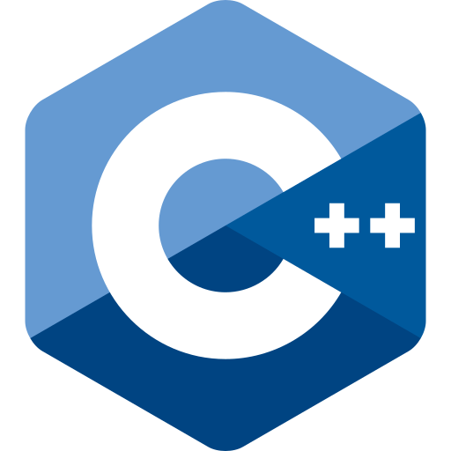
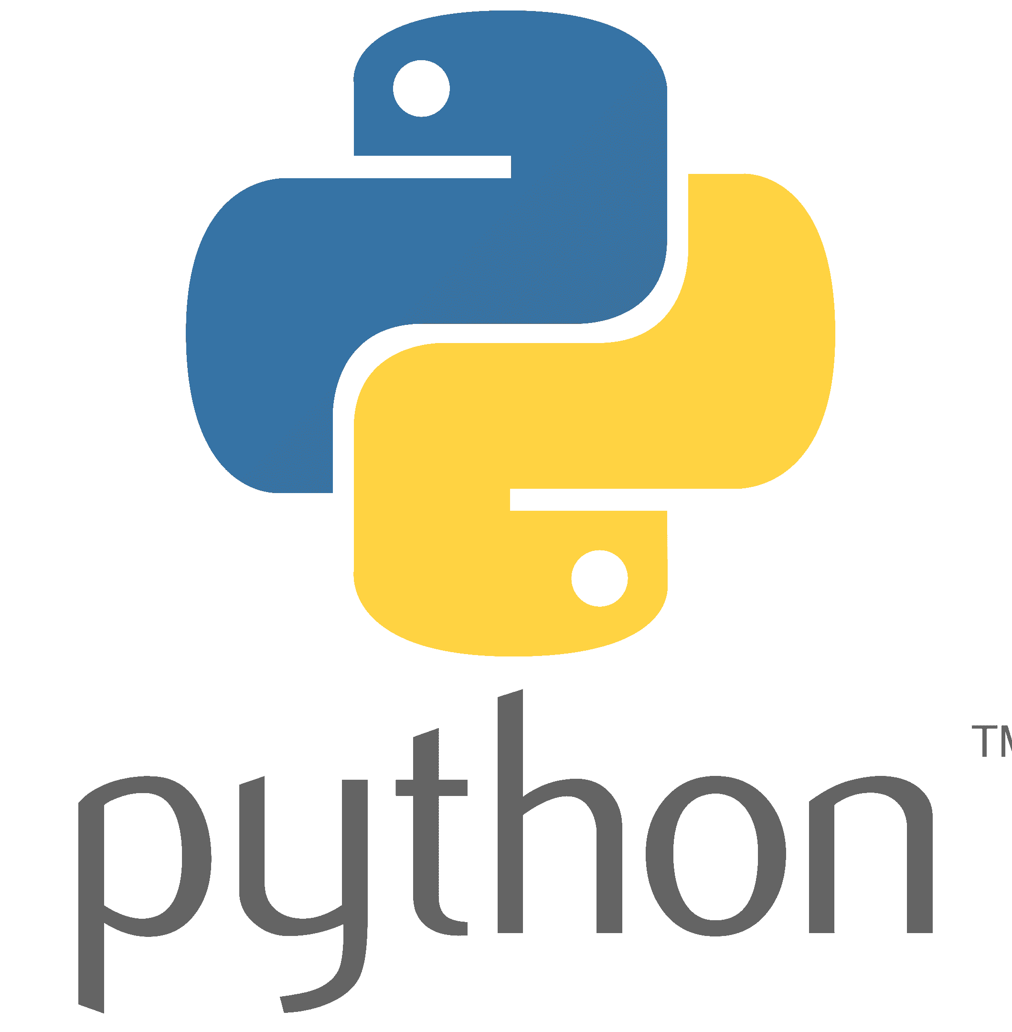
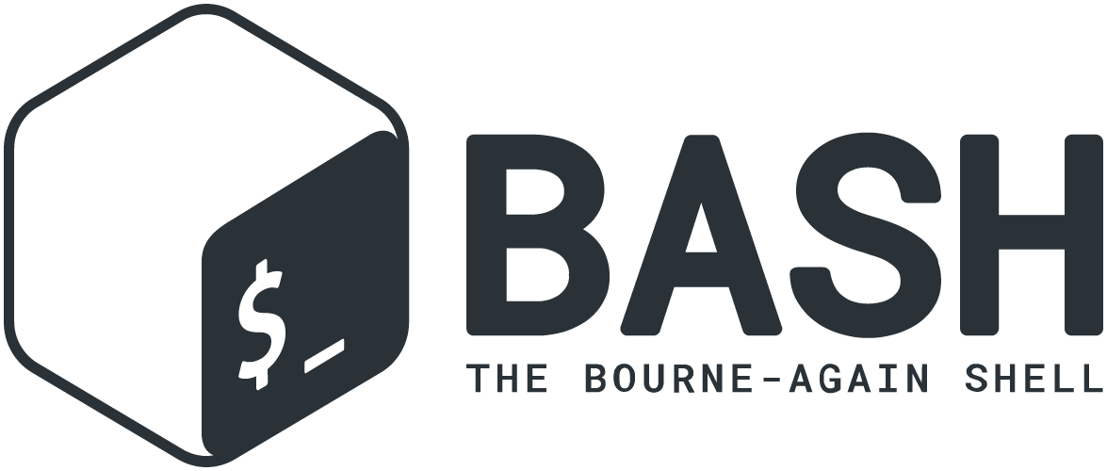
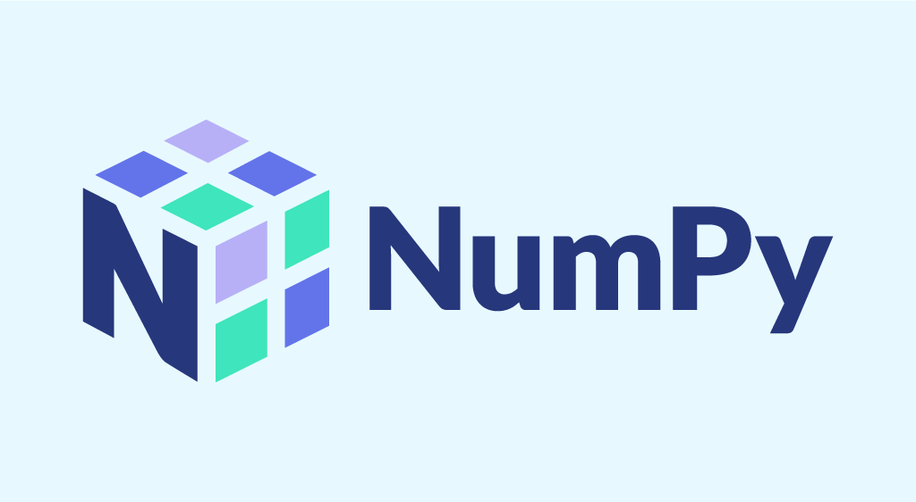

Basic Roadmap for Tech Stack

Slide 15
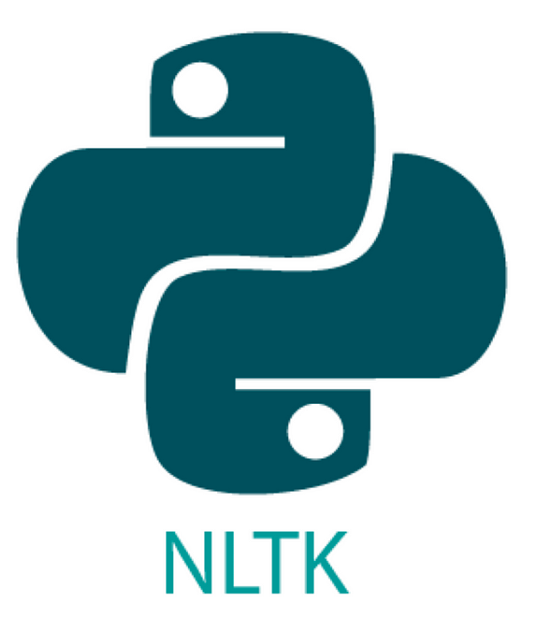


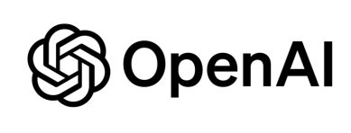

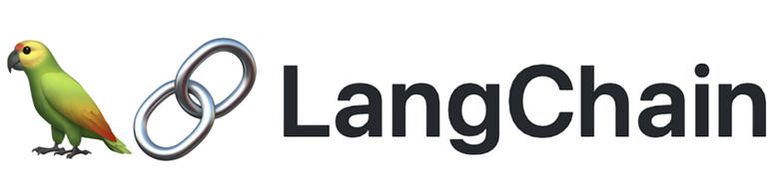
Roadmap for Tech Stack – Natural Language Processing / Understanding

Slide 16


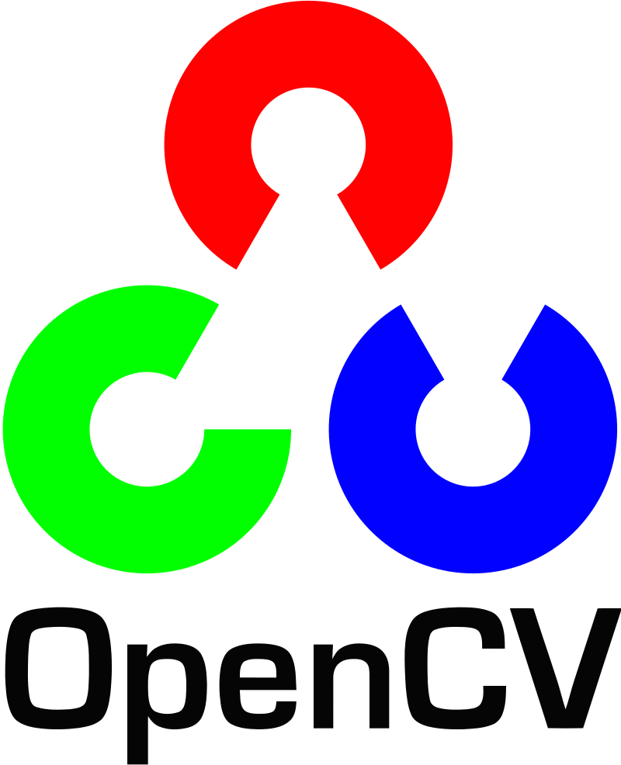


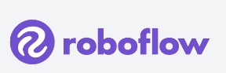
Roadmap for Tech Stack – Computer Vision

Slide 17



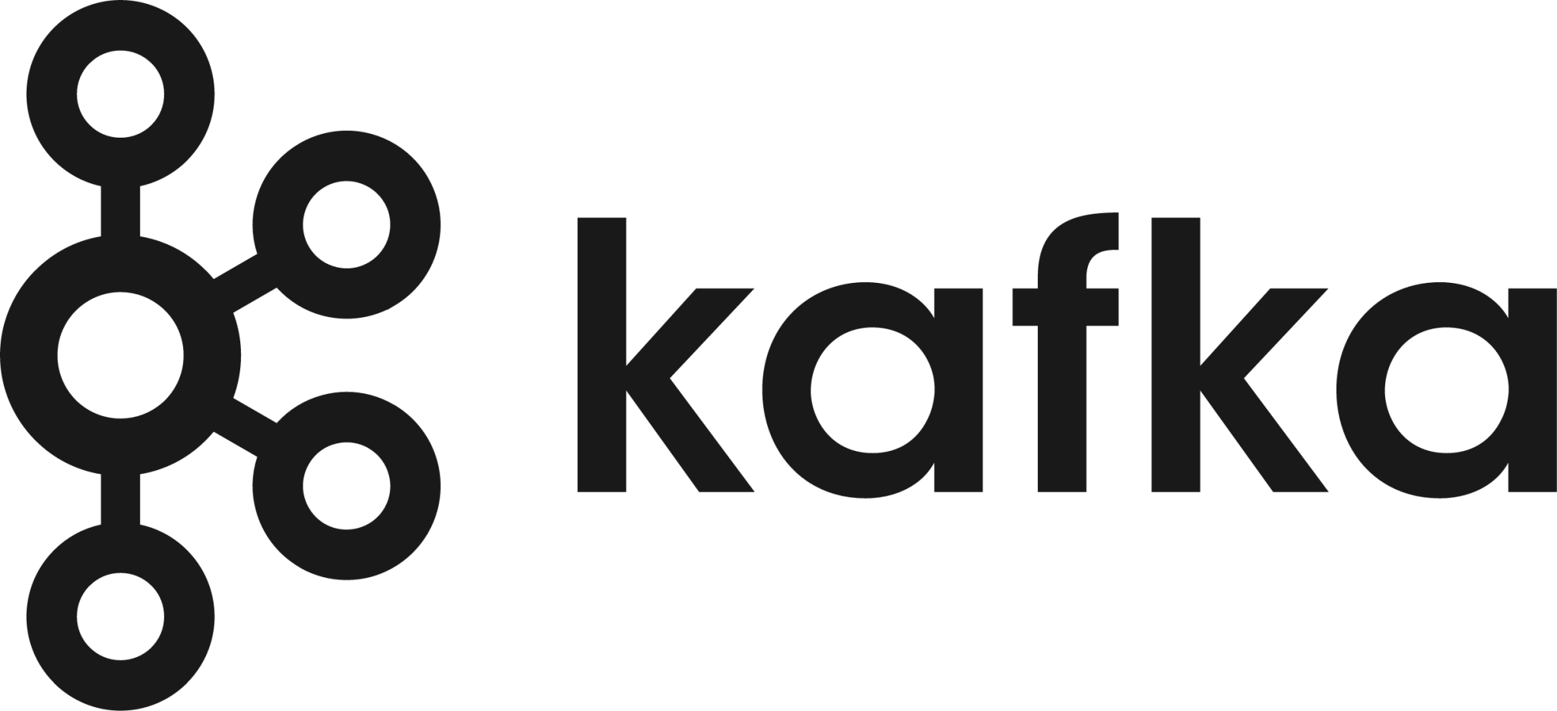
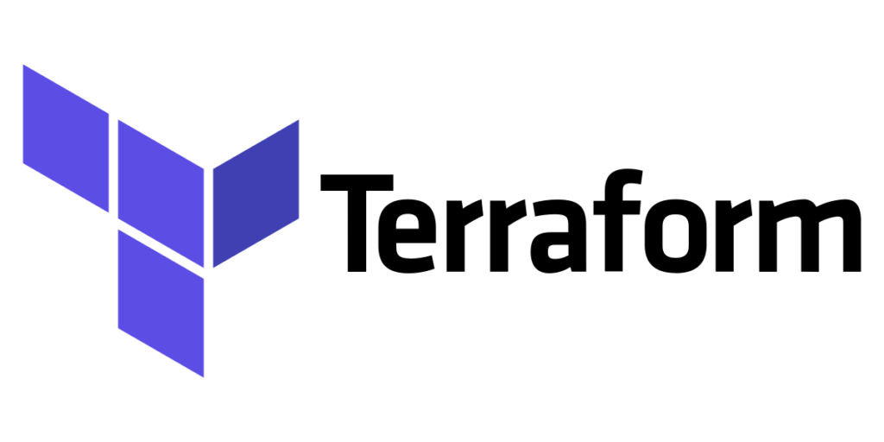
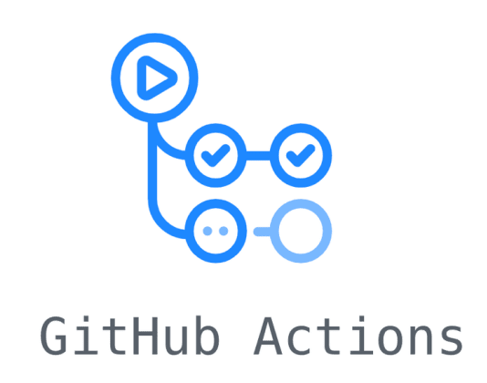
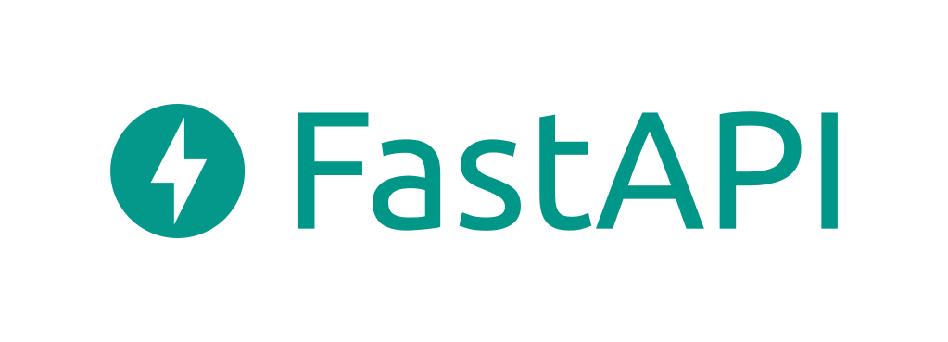




Roadmap for Tech Stack – Machine Learning Operations - MLOps

Slide 18

Therefore studying the roadmap explained will help in
Understand the technology
Identify improvement areas
Customize for specific needs

Slide 19
Hope this helps all of you in appreciating the beautiful technology behind the AI services that we are using

